Slide 1


FINAL PROJECT
ADVERTISING PUSH NOTIFICATIONS PERFORMANCE
Israel SANCHEZ
Nicolas MERLE
02/04/2021

Slide 2
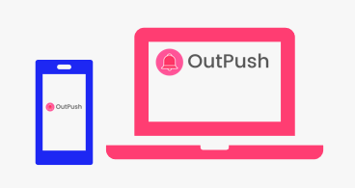
AGENDA
Introduction to Outpush
Push notifications statistical analysis
Push notifications per subscriber
Push notifications probabilities
Conclusion and recommendations

Slide 3
INTRODUCTION
OUTPUSH
What is Outpush?
Push-notifications ads network
Launched in december 2020
Middleman between advertisers and publishers
How does it work?
Clients install a module
Outpush send personalised ads to the client users
1 click = money for the client

Slide 4
INTRODUCTION
PROBLEM STATEMENT
Subscribers receive same notifications multiple times: is it usefull?
Challenges of this project:
Understand how do repeated impressions affect users ‘Click Through Rate’ across time
Perform statistical analysis
*‘Click Through Rate’ = Number of clicks on Ads / Number of impressions of the Ads

Slide 5
INTRODUCTION
KEY FIGURES IN THE DATASET
1.500.000+
push notifications
50.000 +
Subscribers
15.000 +
Different Ads
45 Days
Feb - March
2021

Slide 6
INTRODUCTION
PUSH NOTIFICATIONS FLOW
Notification sent
Received
51% of sent
Not received
No action
77% of received
Closed
22% of received
Opened
1% of received

Slide 7
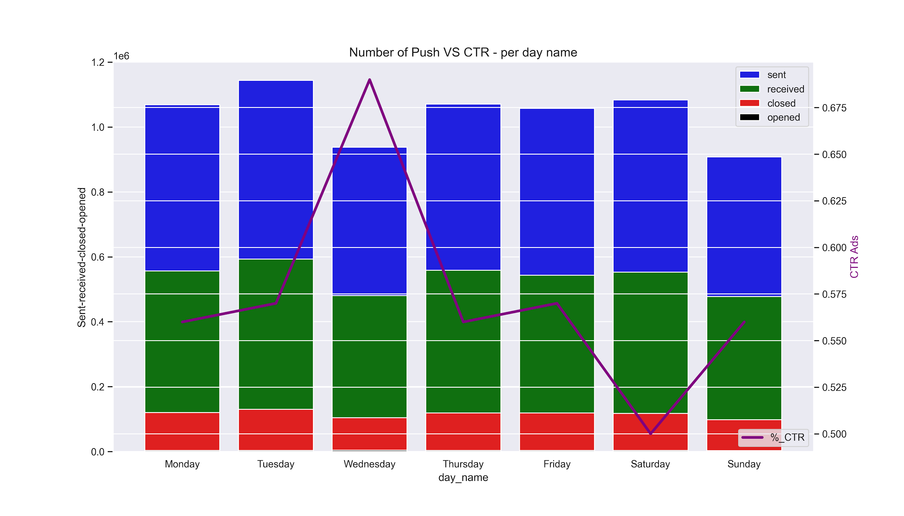
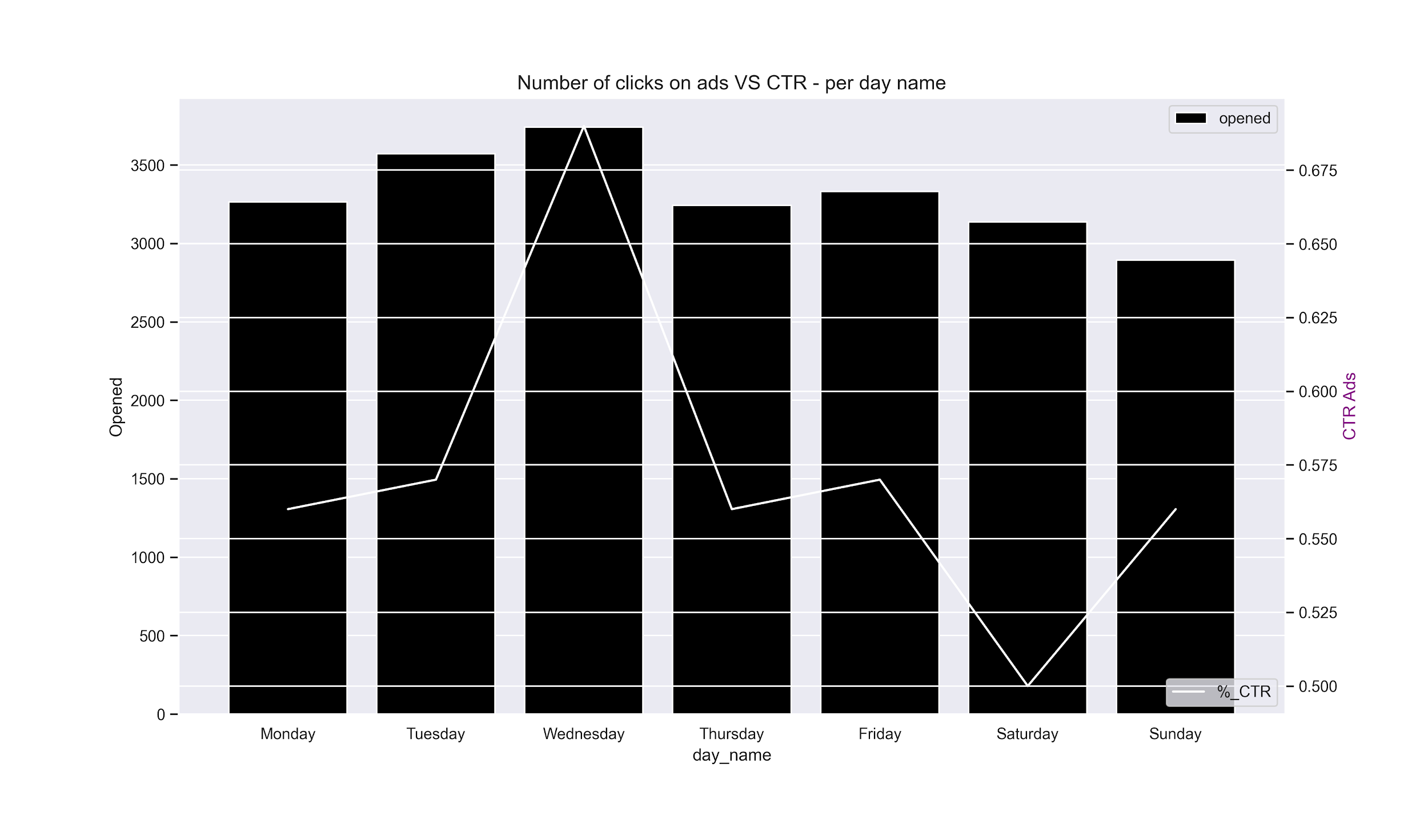
PUSH NOTIFICATIONS STATISTICAL ANALYSIS
PUSH NOTIFICATIONS PER DAY NAME
Higher Click Through Rate on Wednesday
Lower Click Through Rate on Saturday
*values are hidden with a constant

Slide 8
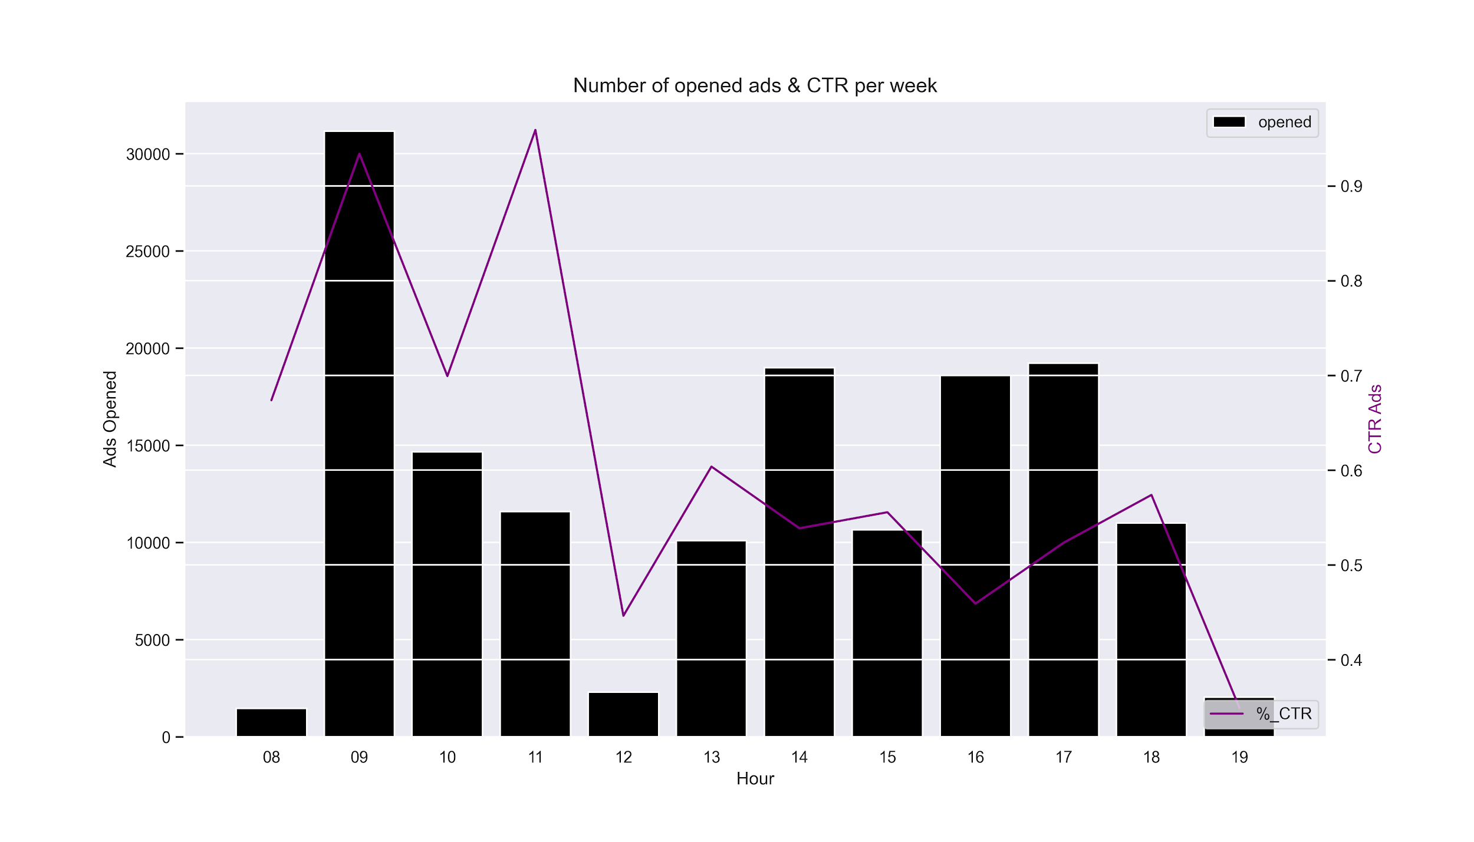
PUSH NOTIFICATIONS STATISTICAL ANALYSIS
PUSH NOTIFICATIONS PER HOUR
Higher CTR: between 09:00 AM and 11:00 AM
*values are hidden with a constant

Slide 9
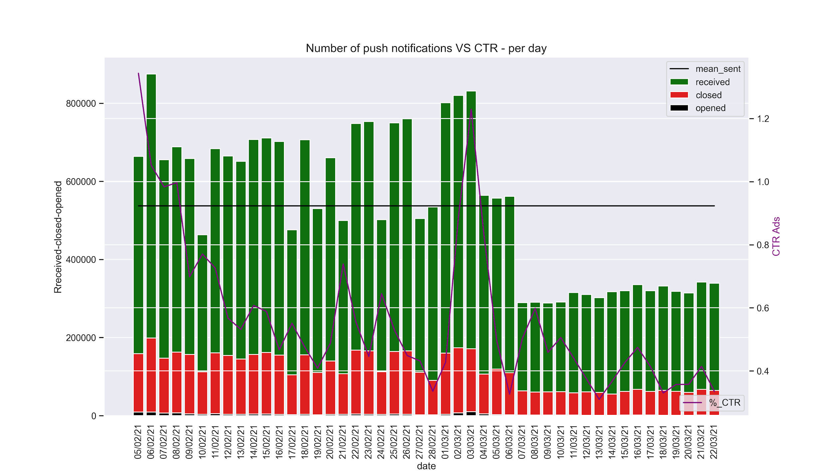
PUSH NOTIFICATIONS STATISTICAL ANALYSIS
PUSH NOTIFICATIONS PER DAY
Drop on the number of push notifications sent from 07.03.2021
*values are hidden with a constant

Slide 10
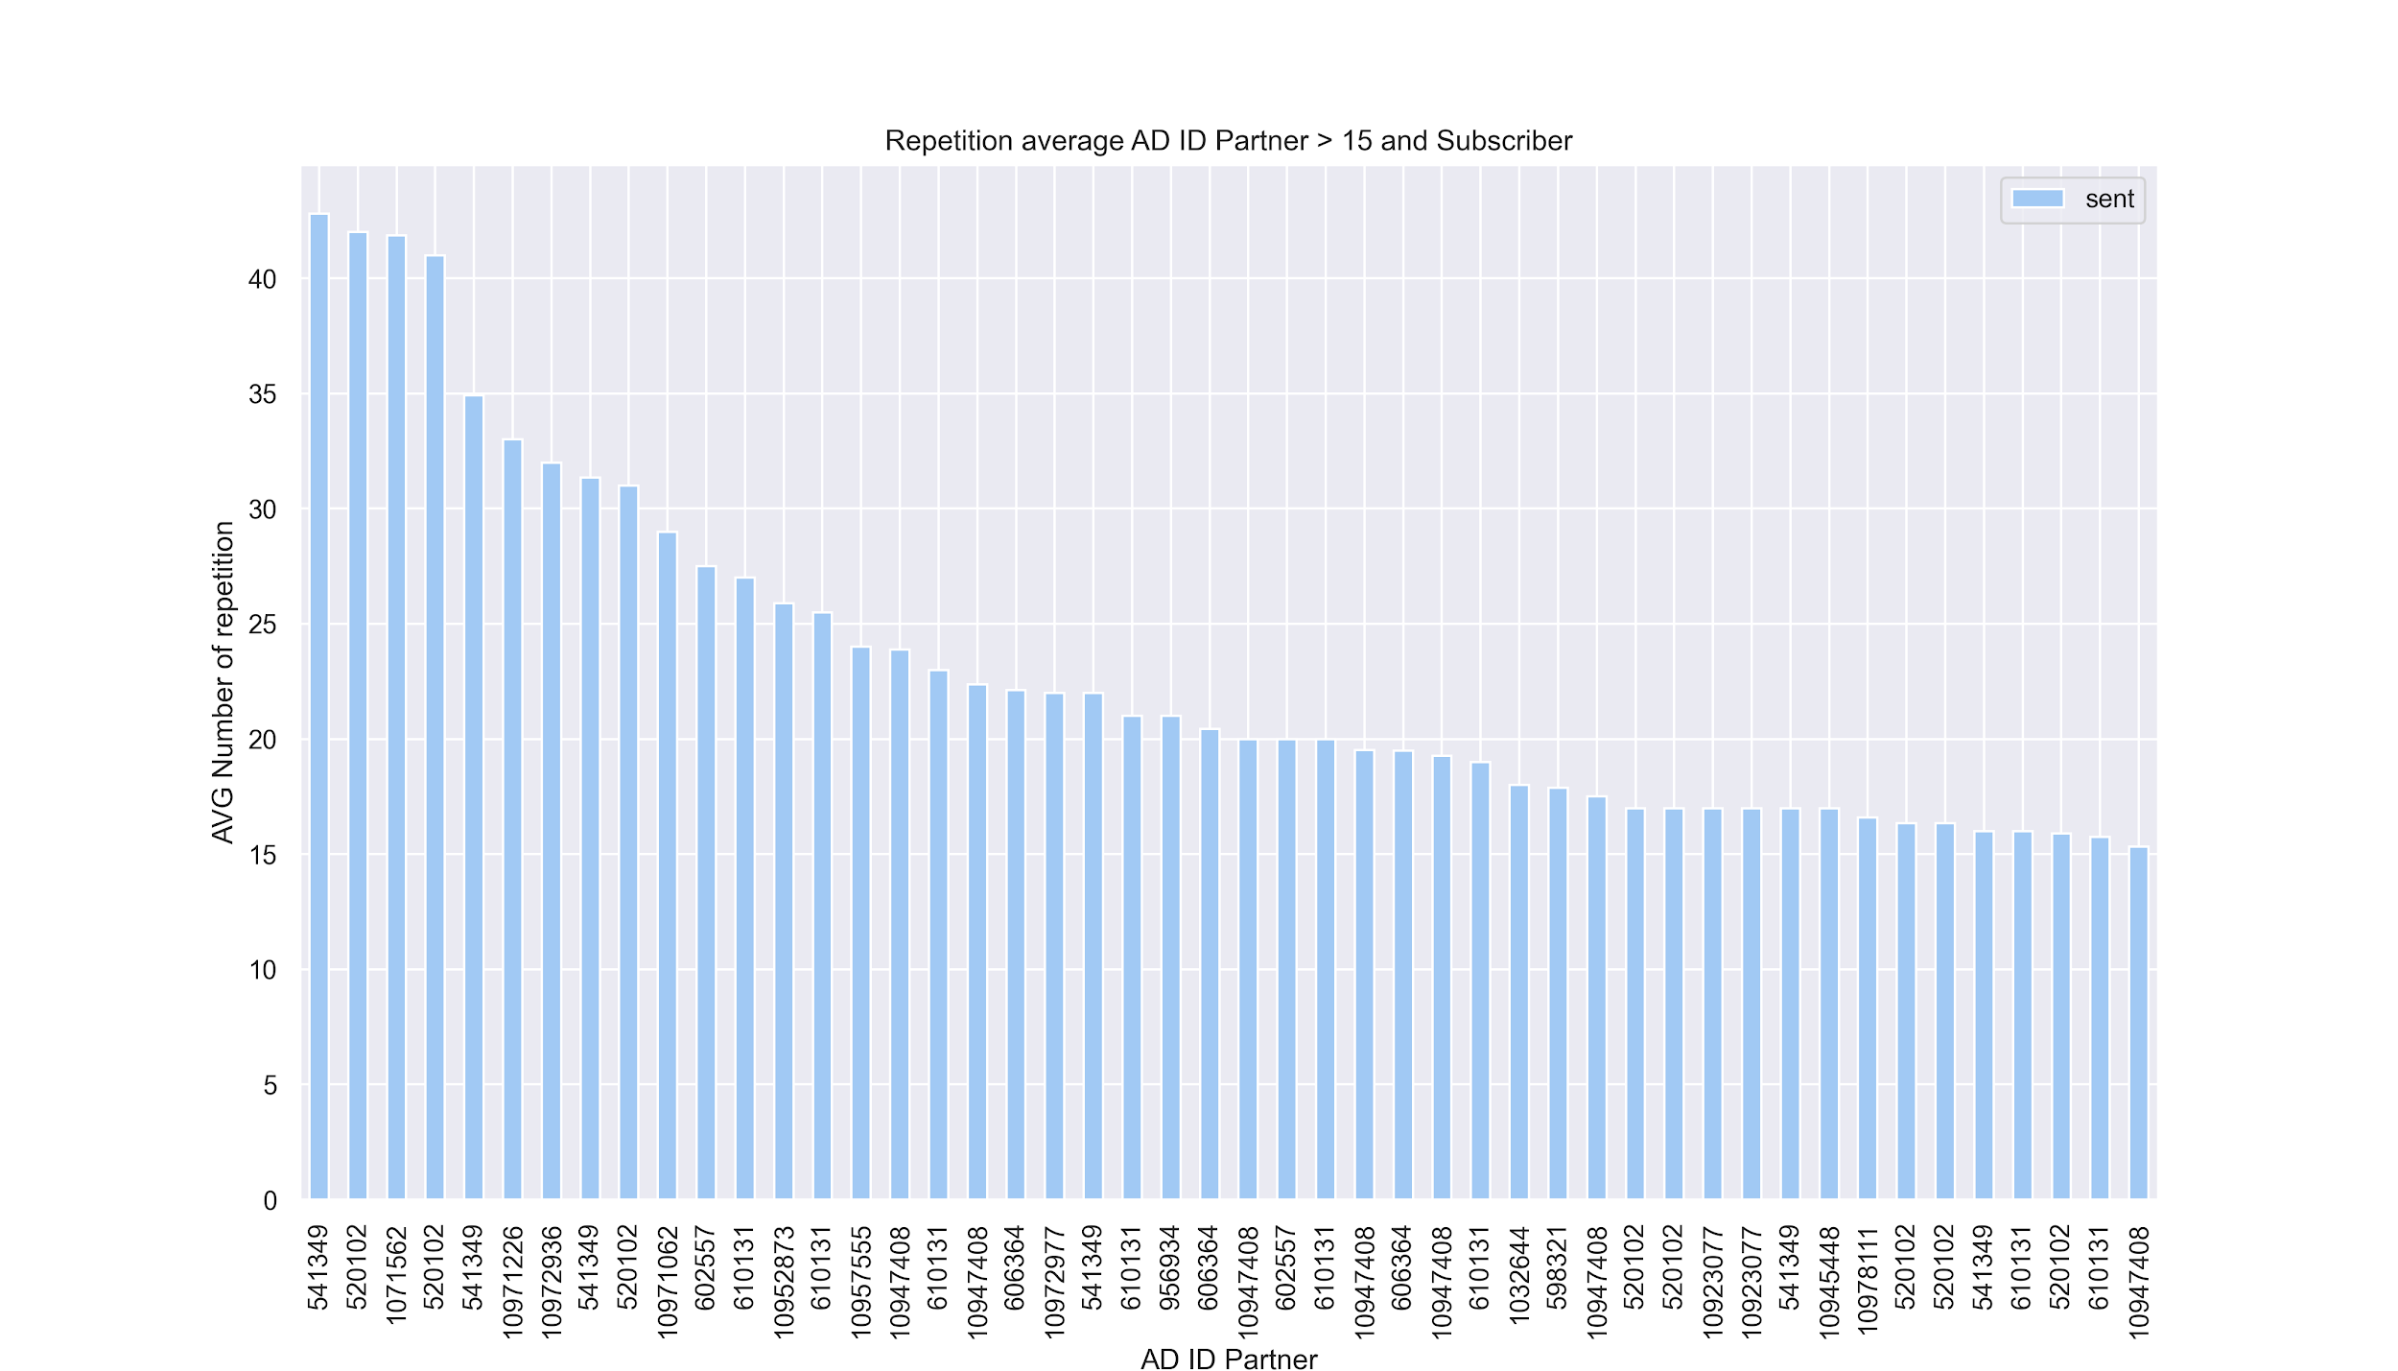
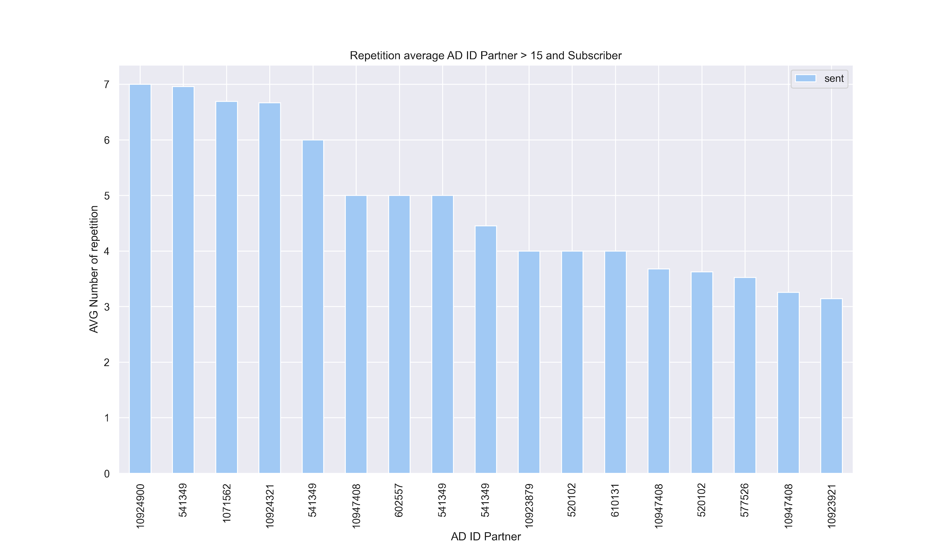
PUSH NOTIFICATIONS STATISTICAL ANALYSIS
ANALYSIS BEFORE AND AFTER 07.03 - ADS REPETITION
High number of repetition per Ads ID before 07/03
Reduced number of repetition per Ads ID after 07/03
We can see that after 07/03 the average of repetition for every ads has been decreased.
*values are hidden with a constant

Slide 11
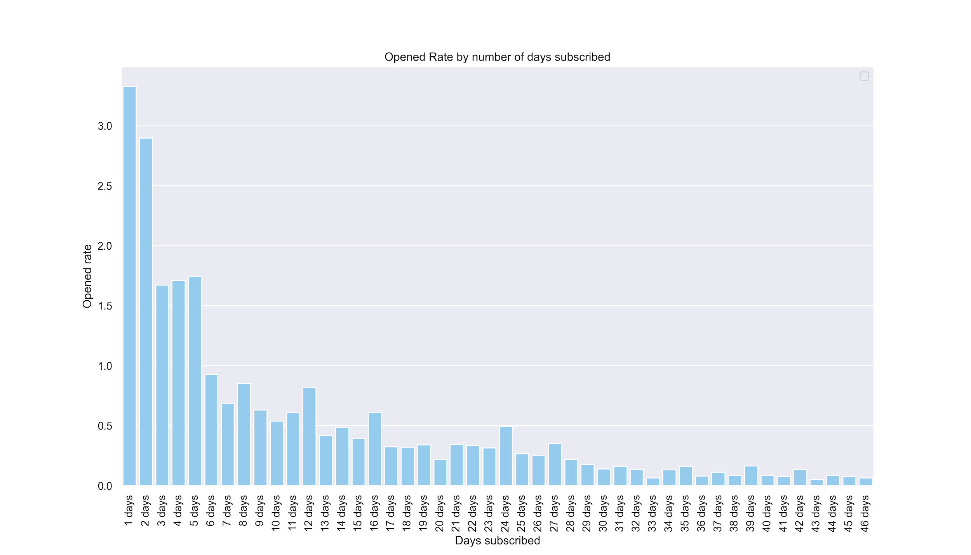
PUSH NOTIFICATIONS PER SUBSCRIBER
ADS OPENED RATE BY NB OF DAYS SUBSCRIBED
The interest on the Ads decreases over time
For boosting Ads opened rate:
A subscriber “interest retention” plan for long time subscribed users.
*values are hidden with a constant

Slide 12
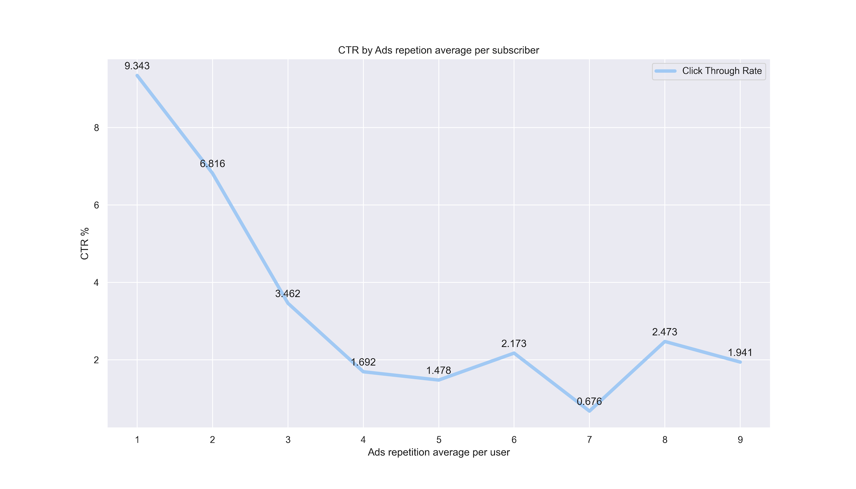
PUSH NOTIFICATIONS PER SUBSCRIBER
CLICK THROUGH RATE BY REPETITION
The click through rate decrease after every repetition of the Ads.
*values are hidden with a constant

Slide 13
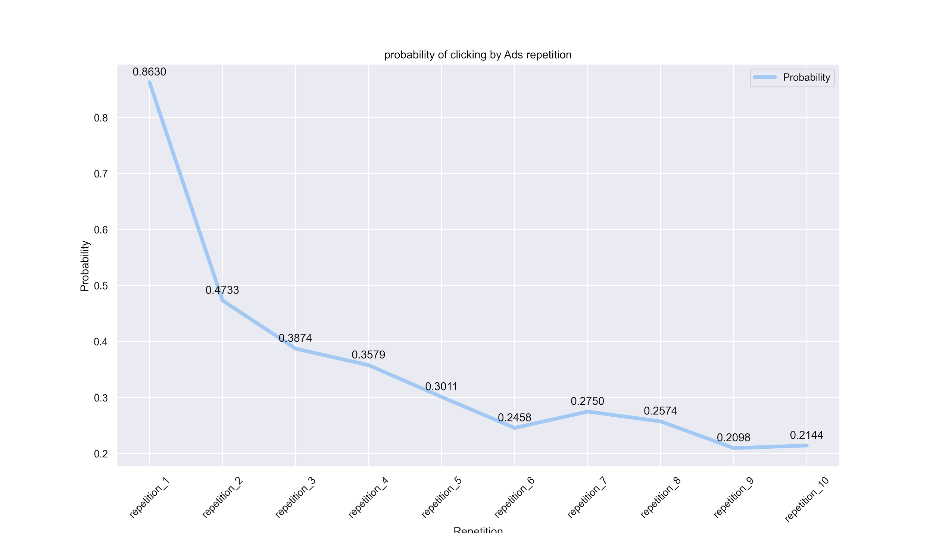
PUSH NOTIFICATIONS PROBABILITIES
ADS OPENING PER REPETITION
Between 1st and 2nd repetition:
important gap
Continuous decrease
*values are hidden with a constant

Slide 14
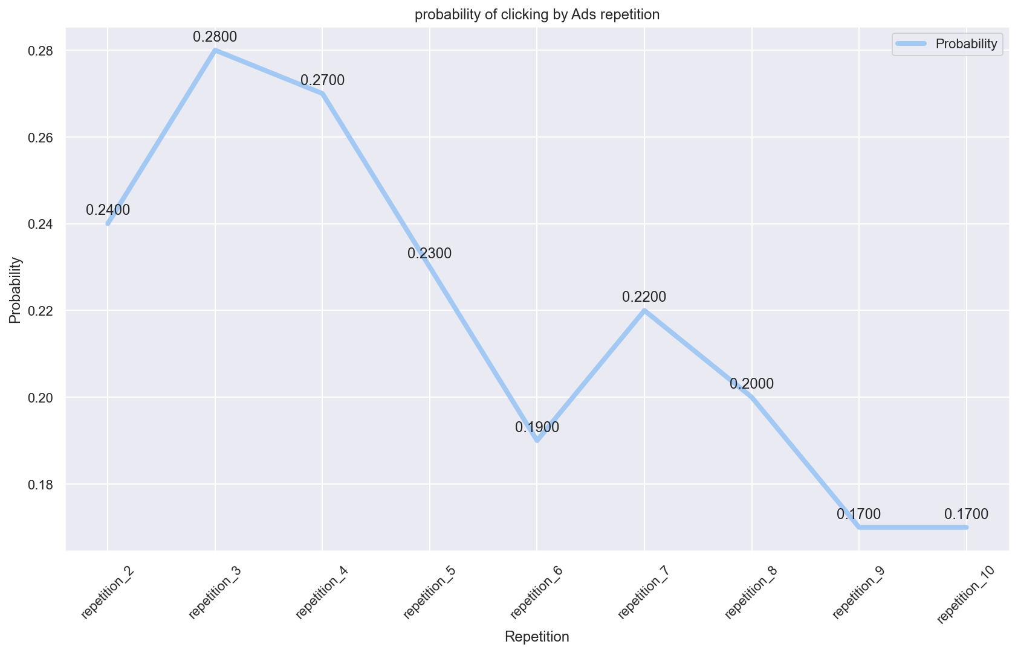
PUSH NOTIFICATIONS PROBABILITIES
CONDITIONAL PROBABILITY OF OPENING THE ADS
Until 3 repetitions:
Between 0.24% - 0.28%
After 4th repetition:
Important decrease
*values are hidden with a constant

Slide 15
CONCLUSIONS AND RECOMMENDATIONS
Boost the notification push during the time periods with higher subscribers activity
Wednesdays are having the higher Click Through Rate
Saturdays are having the lower Click Through Rate
09:00 AM and 11:00 AM are hours of the day with the higher Click Through Rate
Subscribers “Interest retention” plan.
A subscriber “interest retention” plan could help to boost the Ads opened rate for long time subscribed users.
The optimal number of Ads repetition should be in average 4
CTR decreases after every repetition of the Ads.
1st impression: 9.4%
4th repetition: 1.5%
The probability of opening the Ads decrease after every repetition
Probability on the 1st impression: 0.8%
Probability on the 4th repetition: 0.3%
The conditional probability of clicking the add given it was not opened before start dropping in the 4th repetition.

